Slide 1
Group Presentation Introduction
What?
How?
by Vanessa Tu
Notes:
What is it about our simul-speech?
How to prepare for that?

Slide 2
Outline
About “group presentation”
Preparation stages
Opening & Closing
Q & A session

Slide 3
About “Group Presentation”
Important Numbers:
30% in total score
Each one of you:
8 mins per group + 2 mins Q & A
Raters: Classmates

Slide 4
A video of the on-site presentation should be uploaded within one week after your simultaneous speech. (Date will be announced.)
The video is obligatory for you to get the score in simultaneous speech.

Slide 5
Preparation Stage 1: Decide Direction
Write down all the possibilities. (Use Post-it!)
Title should be specific and set around ‘one idea’. (Technique: question & focus on one track)
Will robots cause mass unemployment in the future?
How will ocean acidification impact our world?
Can we stop climate change by removing CO2 from the air?
If superpowers were real: Body mass
Your kids might live on Mars. Here’s how they’ll survive.
→ Stage 3
Notes:
Focus on 3~4 points and find a logic to connect them.

Slide 6
Reminders
Articles in textbook are only for your reference.
Do more research on the points worth sharing from the articles.

Slide 7
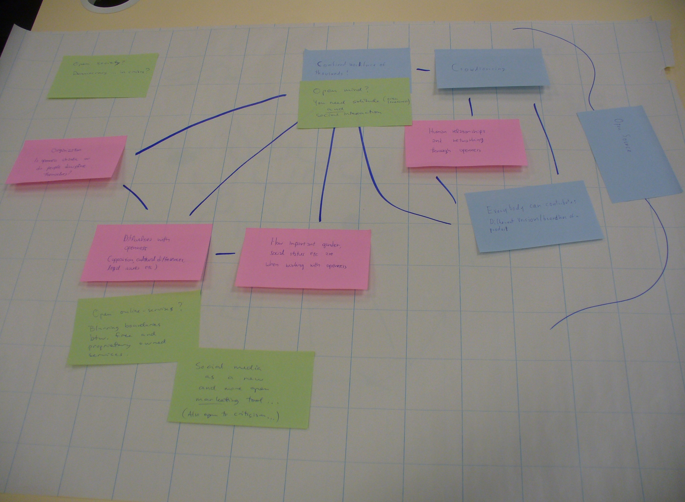

Slide 8
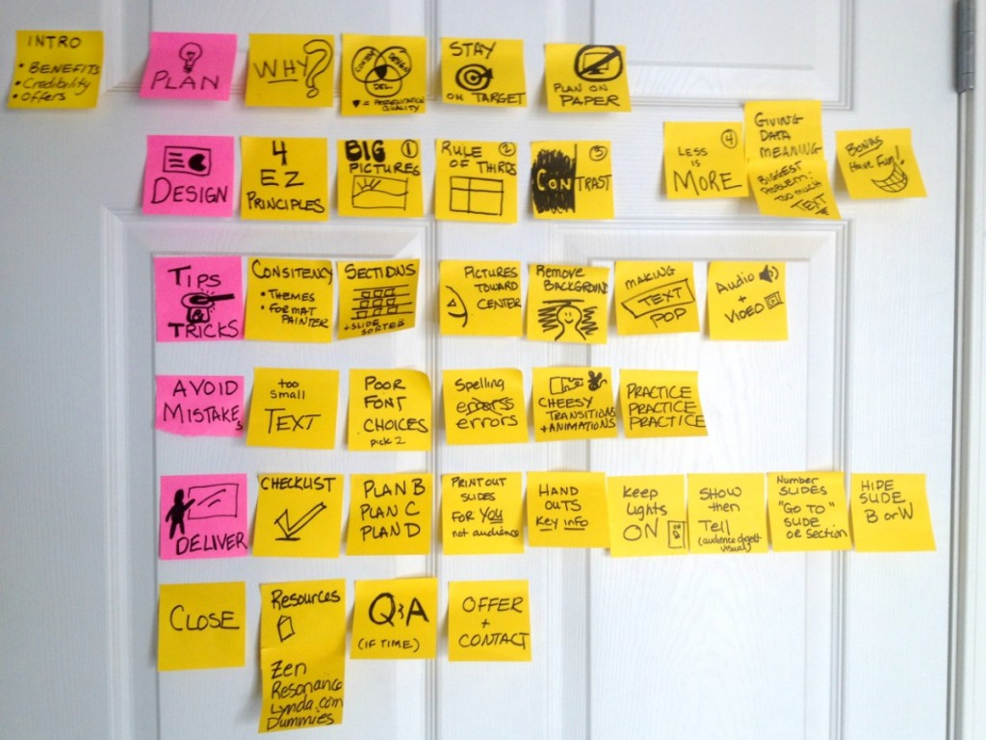

Slide 9
Preparation Stage 2: Prepare Notes
Speech notes & Words on PPT
Don’t copy whole sentences from the reading.
Use your own words!
5 steps:
(1) Circle key words
(2) Write down all the words on a blank paper
(3) Use the words as clues to make your own complete sentences
(4) Ensure the logic link between your main points.
(5) Done!

Slide 10
Don’t summarize each paragraph.
(×) article review
Break down the boundary; set up your own structure and make it logical. Use Post-it!

Slide 11
After Preparation steps,

Slide 12
And then what?

Slide 13
My suggestion

Slide 14
is to start off with

Slide 15
Opening and Closing

Slide 16
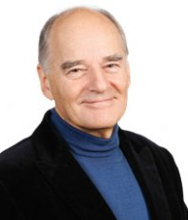
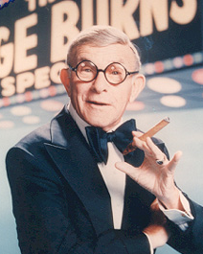
Opening
People tend to remember openers more than any other part of a presentation, except perhaps for the closing remarks.
Andrew Leigh
Associates, www.maynardleigh.co.uk
The secret is: have a good beginning, a good ending and keep them as close together as possible!
George Burns, actor and comedian

Slide 17
4 Elements to Opening a Presentation
A (Attention): Capture your audience’s interest instantly
[Ex.] Almost everyone thinks presentation is a serious task, but what if I say it’s not. To me, it’s a conversation.
B (Benefit): Explain what they will gain from the talk
[Ex.] By the end of this talk you’ll know how to say “No” and feel good about it.
C (Credibility): Show them you have the authority to speak
[Ex.] I am fortunate enough to study (Biotechnology) in National Cheng-kung university where I’ve learned quite a bit about (DNA).
D (Direction): Give them a route map of the presentaion
[Ex.] Our group’s presentation this afternoon is in three main parts. First, ...Second, ... And third, .....

Slide 18
a surprising fact or statistic
a problem or puzzle
OPENERS
Give them
Tell them
Explode
Ask them
Show them
Quote
a joke
somebody well-known
a story or anecdote
a photograph or cartoon
a popular myth
a video
a news headline
to raise their hand
to talk to a neighbor
a question

Slide 19

Closing
Try to make your last line or two truly eloquent, meaningful, touching, accurate and wise. Always memorize your last lines. This is the time to deliver straight to them: eye to eye, person to person. Try to leave them with a thought that will continue to provide an echo after you stop.
Sonya Hamlin
Presentations coach, Harvard Law School

Slide 20
3 Closing Techniques
Summary
Let’s take a look back at what we’ve spoken about this morning.
So, how to sum up?
Action
This research still has a lot to do. We suggest …
So, next time you…, remember to…
Without you and your people, we cannot make this work.
Wisdom
I’m reminded of the words of Thomas A. Edison that “Genius is one percent inspiration and ninety-nine percent perspiration.”

Slide 21
Q & A session – How to respond?
Good questions:
Good point.
That’s a very good question.
I’m glad you ask me that.
Ah, yes, thank you for reminding me.

Slide 22
Q & A session – How to respond?
Off-topic questions:
I think that raises a slightly different issue.
Sorry, I don’t quite see the connection.
Unnecessary questions:
Ah, perhaps I didn’t make that clear.
Well, as I might have mentioned / as I mentioned earlier,…
Multiple questions:
I think there are several questions there.
OK, let’s take those one at a time.
OK, so I think your main question there is…
Hostile questions:
I don’t have that information to hand.
To be quite honest with you, I really don’t know.

Slide 23
Q & A session – How to respond?
Difficult questions:
I’m afraid I don’t know that off the top of my head.
To be quite honest with you, I really don’t know.
I’m afraid I don’t have that information with me.
I’m afraid I don’t know the answer to your question, but I’ll try to find out for you.
What are your thoughts on the matter?
Hmm, I wonder what other people think?
I’m afraid I’m not in a position to answer this question. I’m afraid that’s not my field.
I’ll find out. Can I get back to you on that?
So, if I understood you correctly, you would like to know whether … .
I’m sorry, could you repeat your question, please?
Admit you don’t know.
Ask for other’s opinion.
Find the answer for your audience.
Make more time for yourself.
Notes:
Say you don’t know
Ask for their thinking
Negotiate
Clarify the question

Slide 24
Website Introduction
Feature your points:
Insert a “text box (文字方塊)” or a “shape (圖案)” with larger words in it.
Make sure your audience can see the words and follow your steps easily.

Slide 25
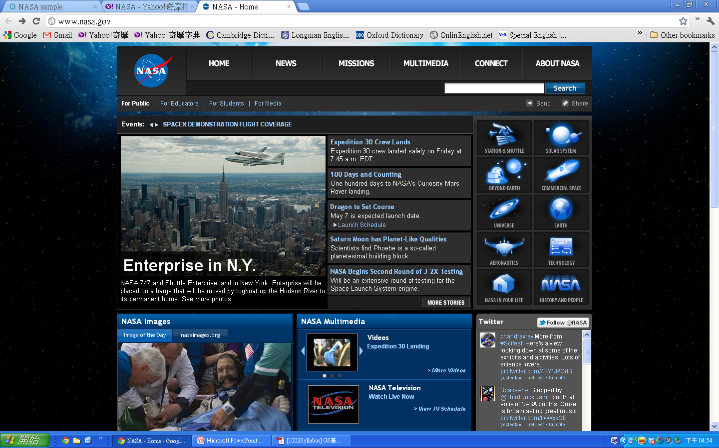
Multimedia
Station and Shuttle
Earth
NASA in Your Life

Slide 26
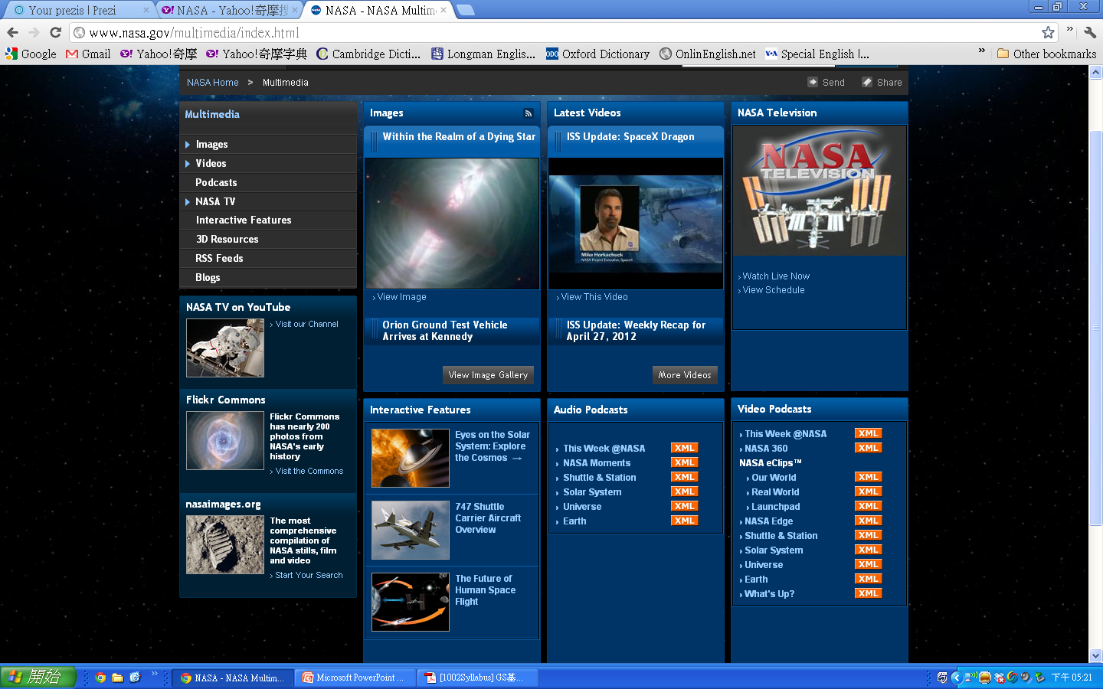
Images
Latest Videos
Interactive
Features
Audio Podcasts
Video Podcasts

Slide 27


